Slide 1
WinGet and DSCv3

Slide 2



Scott Erickson
Sr DevOps Engineer
Recast Software
in/scott-erickson-jr
@scotte.dev

Slide 3

How did I get here? AKA what does this do?

Slide 4
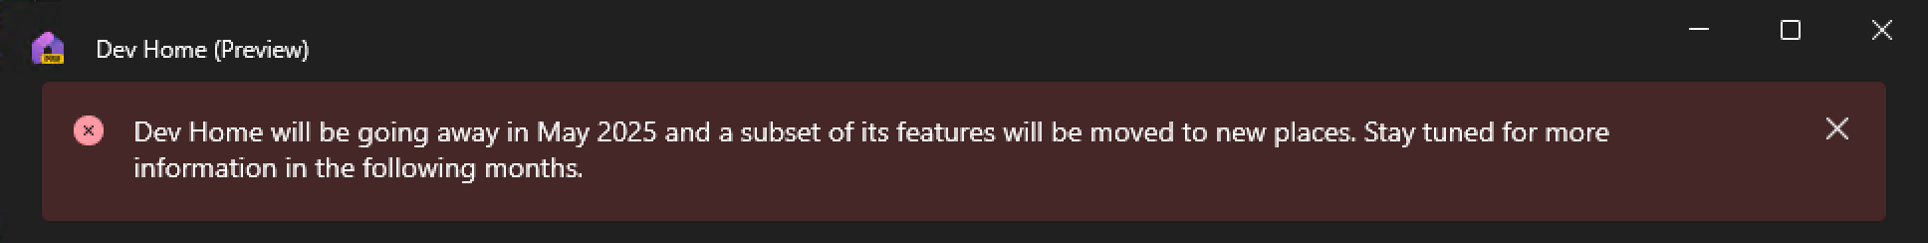
Dev Home
Force installed with Windows 11 23H2
Surfaces Windows features that help Devs
Dev Drive
Clone Repos
File Explorer settings
End Task in taskbar
Registry file preview
Host file editor
Environment Variables Editor

Slide 5
WinGet Configure
WinGet Configure is a feature of the WinGet exe (2023)
Automate software installations, device configuration, regkeys, files
Winget Configuration is declarative and self documenting
Configuration is portable and can be easily added to source control
Always up to date installs with no media to maintain
Useable with Dev Home and Dev Box
Built on top of Microsoft Desired State Configuration v3
Can use any DSC resource with a WinGet configuration file; infinite possibilities

Slide 6
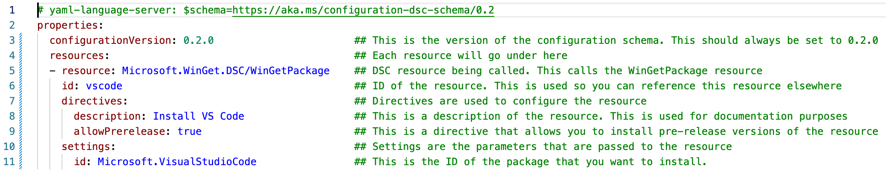
Anatomy of a WinGet Configuration File
YAML format
Save with the extension .winget
Indentation: 2 spaces
To run:
winget configure filename.winget
Resource order does not matter
Command line equivalent of this configuration file:
winget install Microsoft.VisualStudioCode --accept-source-agreements

Slide 7
WinGet Config

Slide 8
Desired State Configuration v3
Just went GA in mid-March
No longer PowerShell based – rewritten in rust
Fully backwards compatible with DSC v1/v2 modules
Cross platform and language independent
No more MOF files
No more Local Configuration Manager
Simple JSON/YAML files for configuration

Slide 9
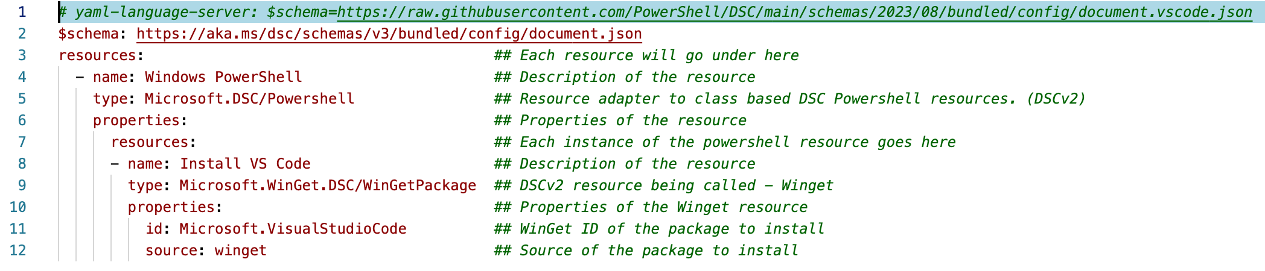
Anatomy of a DSC Configuration File
YAML or JSON format
Save with the extension .dsc.yaml
Indentation: 2 spaces
To run:
dsc config set -f filename.dsc.config.yaml
Resource order does not matter
Command line equivalent of this configuration file:
winget install Microsoft.VisualStudioCode --accept-source-agreements

Slide 10
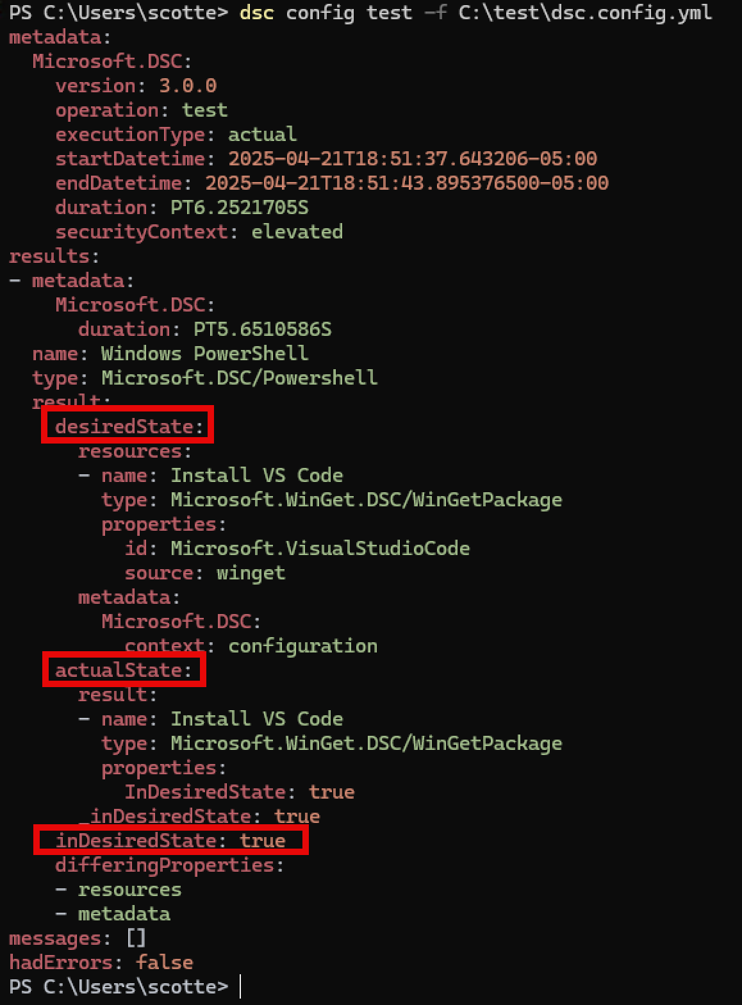
Terminology
Get – Retrieve the current config of the system
Test – Test the current config and compare to desired
Set – Sets/Remediates the system to the desired state
Export – Exports the current state – only works for native resources currently
Resource – Configuration instances – The individual pieces of config
Command Resource – Native DSCv3 resoruces
Adapter Resource – Allows non-native DSCv3 resources
Microsoft.DSC/PowerShell – PowerShell v7 (DSCv2) resources
Microsoft.Windows/WindowsPowerShell – Windows PowerShell (DSCv1) resources
Microsoft.Windows/WMI – Interact with WMI directly
Assertion – Check the state of a machine but don’t change
This is useful for prereq-checks (OS Version)

Slide 11
DSCv3

Slide 12
Gotchas and Limitations
DSCv3 is so new. It is hard to find resources and lots of bugs
DSC and WinGet are both developed in the open.
Steady stream of updates, lots changing
WinGet bugs - https://github.com/microsoft/winget-dsc/issues
DSCv3 bugs - https://github.com/PowerShell/DSC/issues
WinGet Config attempts to auto resolves module dependencies, DSCv3 does not. That is good and bad:
DSCv3 Export isn’t fully able to compare with ReverseDSC yet
Running WinGet as System is annoying – See scripts for how to overcome
WinGet Config doesn’t let you set app context – VSCode installs per user
No simple way to migrate existing DSC configurations to DSCv3
https://github.com/Gijsreyn/PSDSC - Keep an eye on this though

Slide 13
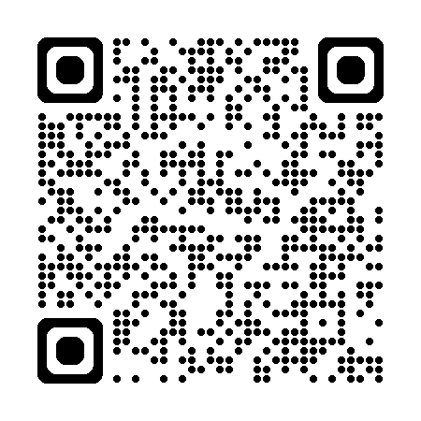
Resources
Session Demos
Windows Sandbox Winget Config
Sample WinGet Configurations
Sample DSC Configurations
PowerShell Gallery – DSC Resources
M365 Reverse DSC
ConfigMgrDSC
Winget Config - MS Learn
WinGet Return Codes

